Slide 1
CS213 – 2022 / 2023
Programming II
Lecture 7: OOP – V static, Copy Constructor, Memberwise Assignment, Destructors, Move Constructor
Cairo University, Faculty of Computers and AI
By
Dr. Mohammad El-Ramly

Slide 2
Quiz 2 – Questions 1 to 6
What is FinTech?
What is the most recommended site for Competitive Programming by S. H.? Why?
What is the name of the series of illustrated book that he suggested that starts with H…?
What is Clean Arch about ?
What did Uncle Bob say about the hardest part in programming ?
What did Motsafa Nageeb say about making a better CV that gets you many interviews?

Slide 3
Quiz 2 – Questions 7 to 9
class Parent {
public:
virtual void function () {
cout << "\nParent Function ";
}
};
class Child: public Parent {
public:
void function () {
cout << "\nChild Function ";
}
};
class GrandChild: public Child {
public:
void function () {
cout << "\nGrandchild Function ";
}
};

Slide 4
Quiz 2 – Questions 7 to 9
What will each of these codes print?
Parent p[3] = {Parent(), Child(), GrandChild()};
for (int i = 0; i < 3; i++)
p[i].funct();
8) Parent* ptr[3] =
{new Parent(), new Child(), new GrandChild()};
for (int i = 0; i < 3; i++)
ptr[i]->funct();
9) Parent p2[3];
for (int i = 0; i < 3; i++)
p2[i].funct();

Slide 5
Lecture Objectives
Static class members
Copy constructor
Memberwise Assignment
Destructors
Move Constructor & Move Assignment

Slide 6
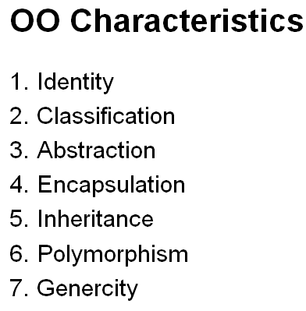
C++ Object System
Object-oriented features
  Classes
  Objects, with dynamic lookup of virtual functions (Polymorphism)
  Inheritance (Subtyping)
    Single and multiple inheritance
    Public and private base classes
  Encapsulation
    Public, private, protected visibility
    Hiding internal details while fixing the external interface

Slide 7
1. Instance and Static Members
instance variable: a member variable in a class. Each object has its own copy.
static variable : one variable shared among all objects of a class
static member function: can be used to access static member variable; can be called before any objects are defined

Slide 8
static member variable
Contents of Tree.h
1 // Tree class
2 class Tree
3 {
4 private:
5 static int objectCount; // Static member variable.
6 public:
7 // Constructor
8 Tree()
9 { objectCount++; }
10
11 // Accessor function for objectCount
12 int getObjectCount() const
13 { return objectCount; }
14 };
15
16 // Definition of the static member variable, written
17 // outside the class.
18 int Tree::objectCount = 0;
Static member declared here.
Static member defined here.

Slide 9
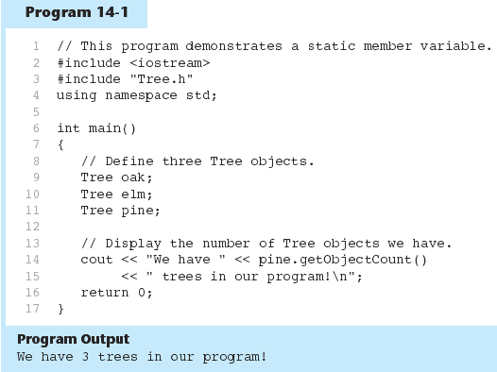

Slide 10
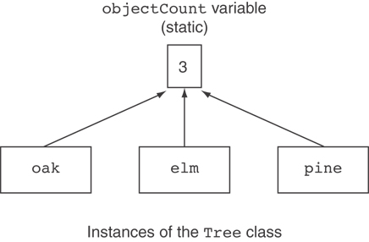
Three Instances of the Tree Class, But Only One objectCount Variable

Slide 11
static member function
Declared with static before return type:
  static int getObjectCount()
  { return objectCount; }
Static member functions can only access static member data
Can be called independent of objects:
int num = Tree::getObjectCount();
Or through any object:
Tree oak;
int num = oak.getObjectCount();

Slide 12
Modified Version of Tree.h
1 // Tree class
2 class Tree
3 {
4 private:
5 static int objectCount; // Static member variable.
6 public:
7 // Constructor
8 Tree()
9 { objectCount++; }
10
11 // Accessor function for objectCount
12 static int getObjectCount()
13 { return objectCount; }
14 };
15
16 // Definition of the static member variable, written
17 // outside the class.
18 int Tree::objectCount = 0;
Now we can call the function like this:
cout << "There are " << Tree::getObjectCount()
<< " objects.\n";

Slide 14
2. Copy Constructor
A copy constructor is a special constructor for a class / struct that is used to make a copy of an existing instance.
According to the C++ standard, the copy constructor for MyClass must have one of the following signatures:
MyClass( const MyClass& other );
MyClass( MyClass& other );

Slide 15
Copy Constructors
The compiler automatically supplies both a copy constructor and an assignment operator if we don't explicitly provide them.
Both of these member functions perform copy operations by performing a memberwise copy from one object to another.
When pointers are not members of a class, this is enough.
For memory dynamically allocated, it is not.

Slide 16
Copy Constructor
If you do not declare a copy constructor, the compiler gives you one implicitly. That does member-wise copy of the source object.
class MyClass {
int x;
char c;
std::string s;
}
This is like
MyClass::MyClass( const MyClass& other ):
x(other.x ), c(other.c ), s(other.s)
{}

Slide 17
Shallow vs Deep Copying
This makes a “shallow copy”
In many cases, this is sufficient.
When the object has pointers, most likely you want to copy what the pointer points to, not the address in the pointer itself. You want to make a “deep copy”.
This is because you want your own copy of data members and not to share with the given object.

Slide 18
Multiple delete
Also, because the instance that owns the pointer is responsible for calling delete on the pointer at some point (probably the destructor).
If two objects end up calling delete on the same non-NULL pointer, heap corruption results.

Slide 19
Shallow / Deep Copy
Shallow Copy:
  The data members of one object are copied into the data members of another object without taking any dynamic memory pointed to by those data members into consideration. (“memberwise copy”)
Deep Copy:
  Any dynamic memory pointed to by the data members is duplicated and the contents of that memory is copied (via copy constructors and assignment operators -- when overloaded)

Slide 20
Copy Constructors
Problems occur with shallow copying when we:
  initialize an object with the value of another object:
  name s1; name s2(s1);
  pass an object by value to a function or when we return by value:
  name function_proto (name)
  assign one object to another:
  s1 = s2;

Slide 21
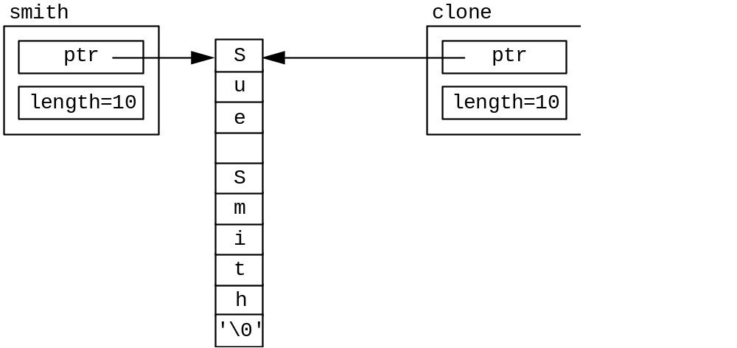
Copy Constructors
If name had a dynamically allocated array of characters (i.e., one of the data members is a pointer to a char),
  the following shallow copy is disastrous!

Slide 22
Copy Constructors
To resolve the pass by value and the initialization issues, we must write a copy constructor whenever dynamic member is allocated on an object-by-object basis.
They have the form:
class_name (const class_name &class_object);
Notice the name of the “function” is the same name as the class, and has no return type
The argument’s data type is that of the class, passed as a constant reference (think about what would happen if this was passed by value?!)

Slide 23
Copy Constructors
//name.h interface
class name {
public:
name(char* = ""); //default constructor
name(const name &); //copy constructor
~name(); //destructor
name& operator=(name &); //assignment op
private:
char* ptr; //pointer to name
int length; //length of name including nul char
};
#include "name.h" //name.c implementation
name::name(char* name_ptr) { //constructor
length = strlen(name_ptr); //get name length
ptr = new char[length+1]; //dynamically allocate
strcpy(ptr, name_ptr); //copy name into new space
}
name::name(const name &obj) { //copy constructor
length = obj.length; //get length
ptr = new char[length+1]; //dynamically allocate
strcpy(ptr, obj.ptr); //copy name into new space
}

Slide 24
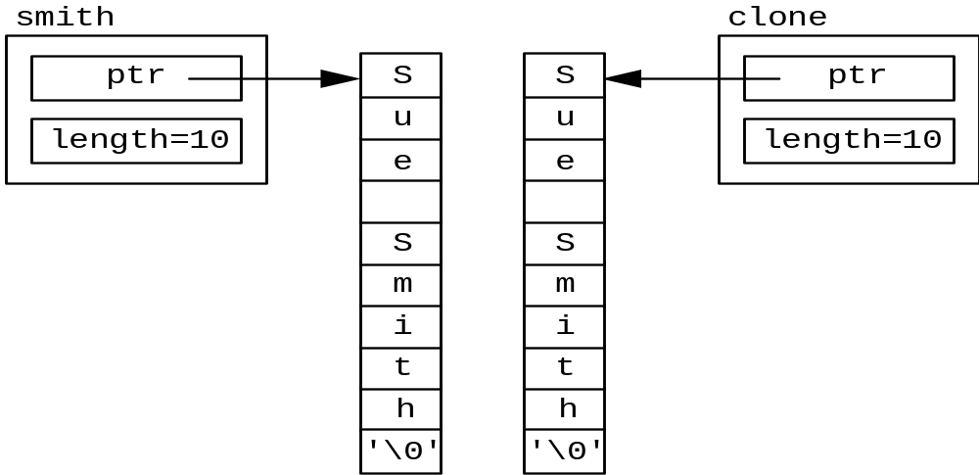
Copy Constructors
Now, when we use the following constructors for initialization, the two objects no longer share memory but have their own allocated

Slide 25
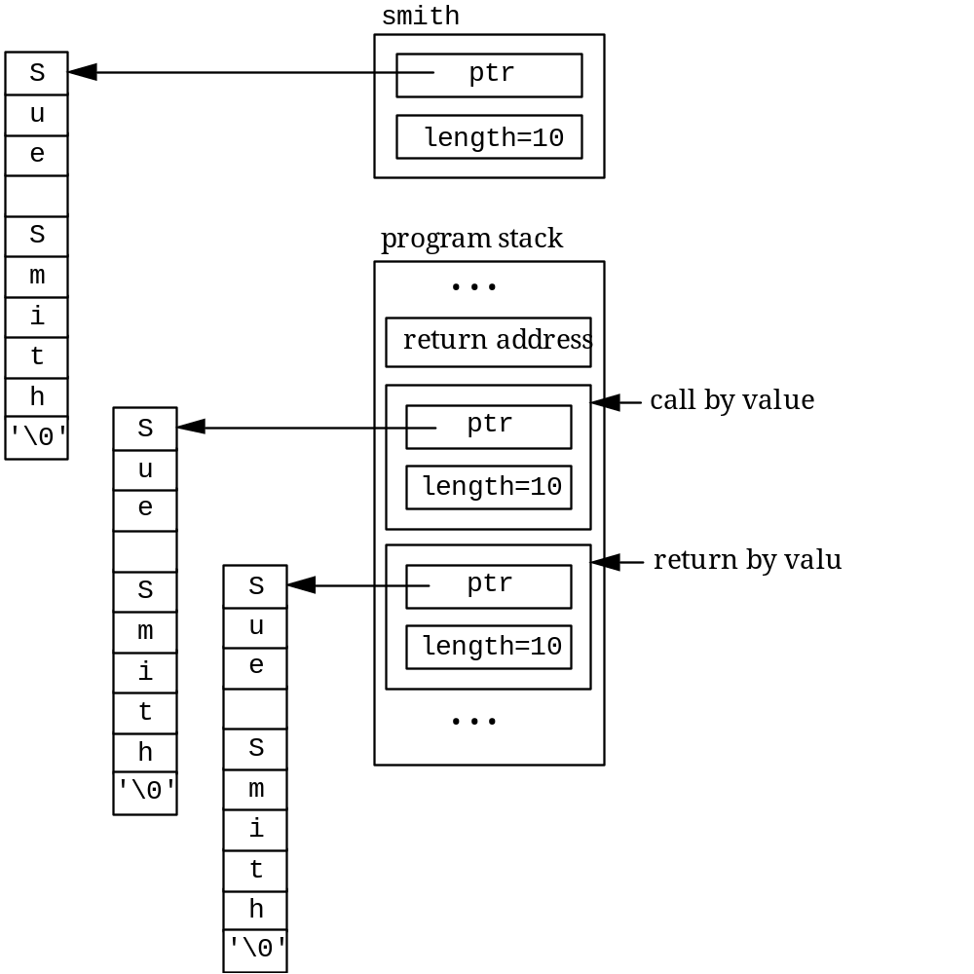
Copy Constructors
Using a copy constructor avoids objects “sharing” memory -- but causes this behavior
This should convince us to avoid pass by value whenever possible -- when passing or returning objects of a class!

Slide 26
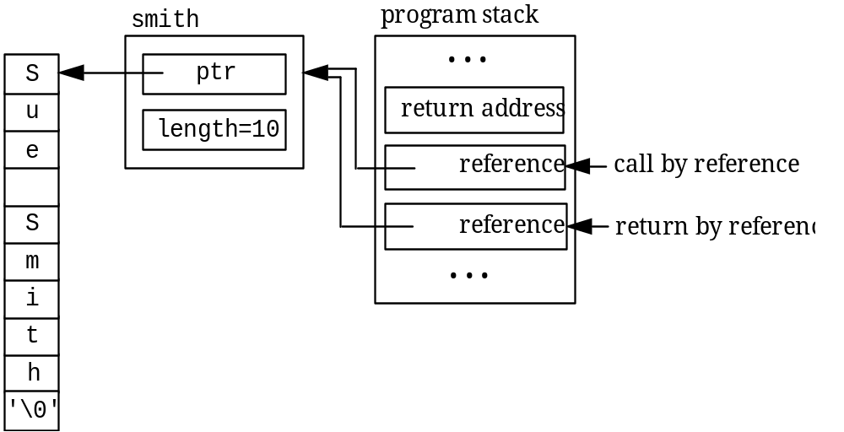
Copy Constructors
Using the reference operator instead, we change the function to be: (the function call remains the same)
name& function(name &obj) {
cout <<obj.get_name() <<endl;
return (obj);
}

Slide 28
3.Memberwise Assignment
Can use = to assign one object to another, or to initialize an object with an object’s data
Copies member to member. e.g.,
  instance2 = instance1; means:
  copy all member values from instance1 and assign to the corresponding member variables of instance2
Use at initialization:
  Rectangle r2 = r1;

Slide 29
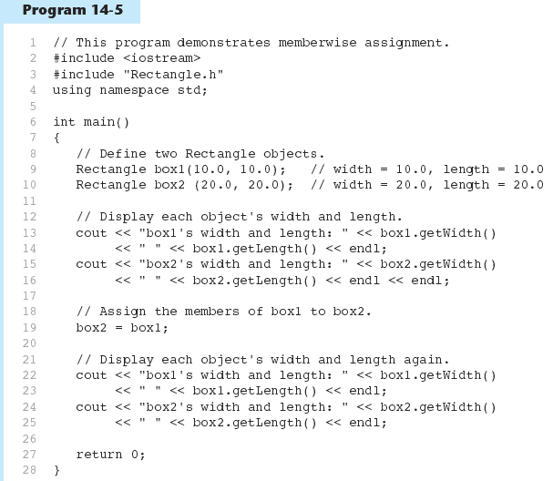

Slide 30
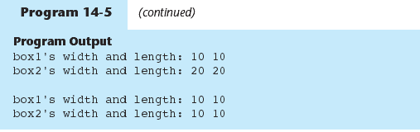

Slide 31
Rule of THREE
If you need to define a copy constructor, then you need also to define copy assignment and destrcutor.

Slide 33
4. Destructors
What is a destructor?
Why using destructors?
Virtual destructors.

Slide 34
4.1 What Is a Destructor ?
A function that is called automatically at the end of the life of an object.
It has the same name as Constructor with ~
  Person::~Person() { ….}
It does give the object a respectable burial
  Print any closing messages
  Release any memory in allocated in the heap

Slide 35
4.2 Why Using Destructors?
Destructor destroys the class objects created by constructor.
It is not possible to define more than one destructor.
Destructor takes no arguments and returns no value.
It is automatically called when object goes out of scope.
In destructor, objects are destroyed in the reverse of an object creation.
Child destructor is called before parent’s one.

Slide 36
Constructors and Destructors
When an object is dynamically allocated with the new operator, its constructor executes:
Rectangle *r = new Rectangle(10, 20);
When the object is destroyed, its destructor executes:
delete r;

Slide 37
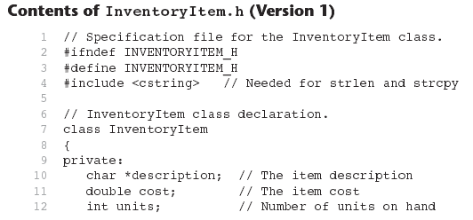

Slide 38
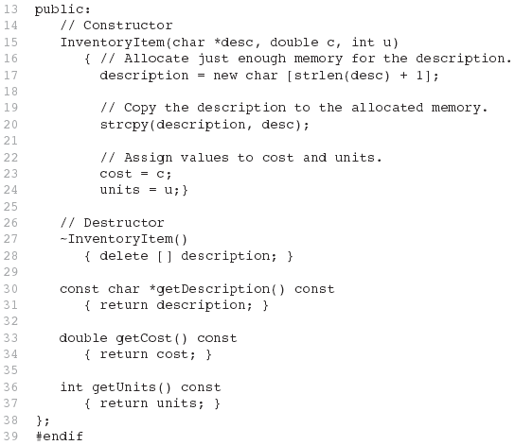
Contents of InventoryItem.h Version1
(continued)

Slide 39
4.3 virtual Destructor
A constructor cannot be virtual because at the time when the constructor is invoked the virtual table would not be available in the memory. Hence we cannot have a virtual constructor.
Destructors should be virtual for base class => Let the computer know which one to call for deallocation.

Slide 40
virtual Destructor
A virtual destructor is one that is declared as virtual in the base class and is used to ensure that destructors are called in the proper order.
It is to be remembered that destructors are called in the reverse order of inheritance.
If a base class pointer points to a derived class object and we some time later use the delete operator to delete the object, then the derived class destructor is not called.

Slide 41
#include <iostream.h>
class Base
{
public:
~Base()
{}
};
class Derived : public Base
{
public:
~Derived()
{}
};
void main()
{
Base *ptr = new Derived();
// some code
delete ptr;
}
In this case the type of the pointer would be considered.
Hence as the pointer is of type base, the base class destructor would be called but the derived class destructor would not be called at all.
The result is memory leak.
In order to avoid this, we have to make the destructor virtual in the base class.

Slide 42
#include <iostream.h>
class Base
{
public:
virtual ~Base()
{}
};
class Derived : public Base
{
public:
~Derived()
{}
};
void main()
{
Base *ptr = new Derived();
// some code
delete ptr;
}
no memory leak here.

Slide 43
Diagnosis
If not declared virtual, compiler uses type of pointer to decide which method to call
  in this case, ptr is of type Base, so the Base destructor will get called
  memory leak from derived class object (how?)‏
solution: always declare destructors virtual, even if no other virtual functions

Slide 45
5. Move Constructor
Introduced in C+11
Instead of copying, it moves ownership of right hand side object to the left one.
It avoids costly unnecessary deep copying that happens when objects are passed by value
First we need to understand some basic new concepts.

Slide 46
Motivating Example
T fun (T Obj) {
T temp;
...
retur temp;
}
T x = fun (some_obj);
// Two copying process happen

Slide 47
Motivating Example
T fun (T& Obj) {
T temp;
...
retur temp;
}
T x = fun (some_obj);
// We reduced them to one

Slide 48
Move Semantics
A solution to unnecessary copying process.
Move ownership of the internal temporary object (rvalue) to the external one without copying it.

Slide 49
Lvalues and Rvalues
int num = 5;
int* ptr = &num;
num = 900;
num is called Lvalue (can understand it as left value)
  Addressable memory location
  Cannot be moved
  Can be reassigned
  Appears on the LHS of assignment

Slide 50
Lvalues and Rvalues
int num = 5;
int* ptr = &5; // WRONG
int num2 = num + 1;// Temporary
int num3 = fun(10);// Temporary
5 and num + 1 are called Rvalue (can understand it as right value)
  Non-addressable memory location
  Cannot be reassigned but can be moved
  Appears on RHS of = and is a literal or temporary
int num2 = num1; //Both Lvalue

Slide 51
Lvalue and Rvalue References
Lvalue reference is the old C++ reference
Can be bound (assigned) to Lvalues ONLY
U can bind const Lvalue reference to Rvalue
  int& n_ref = num;
  int& n_ref = 10; // Wrong
  int& n_ref = sqrt(4); // Wrong
  const int& n_ref = 10; // OK
  const int& n_ref = sqrt(10);// OK
  // will keep result memory alive

Slide 52
Lvalue and Rvalue References
Rvalue reference is new a category of reference variables for unnamed objects (temporaries) in C++11
Can bind only to rvalues
Represented by &&
Any expression producing temporary results is Rvalue
  int&& n_ref = 10; // OK
  int&& n_ref = sqrt(10); // OK

Slide 53
Exercise: Where are L and Rvalues?
int a {}, b {1}, c {-2};
a = b + c;
double r = abs(a * c);
auto p = pow(r, abs(c));

Slide 54
Exercise: Which red statements are valid?
int a {}, b {1}, c {-2};
int* x = &(b + c);
int* y = &abs(a * c);
int* z = &123;
int* w = &a;
int* u = &v.at(2);

Slide 55
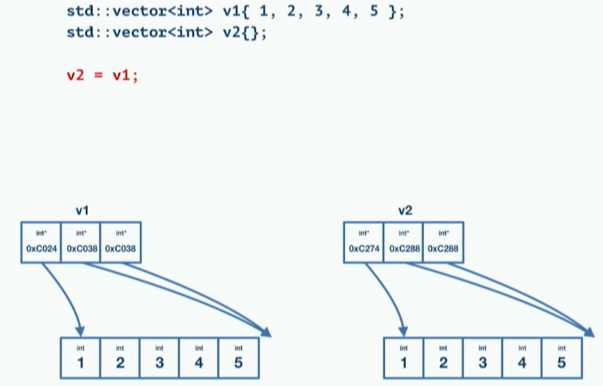
Move Semantics

Slide 56
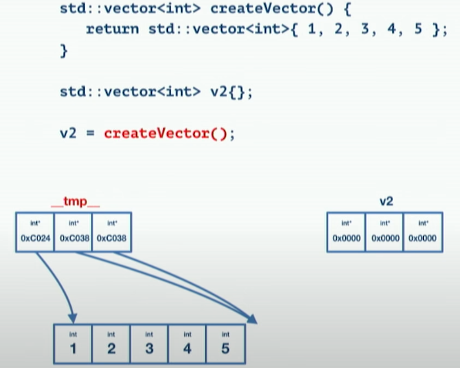
Move Semantics
(This is the
desired action)

Slide 57
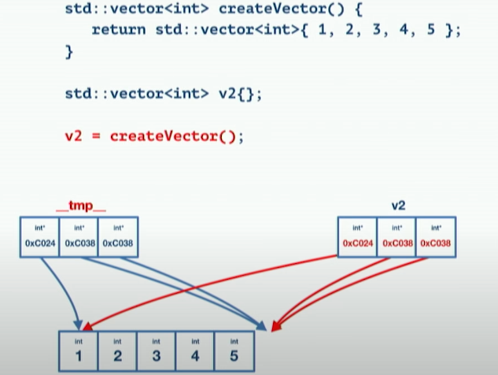
Move Semantics
(This is the
desired action)

Slide 58
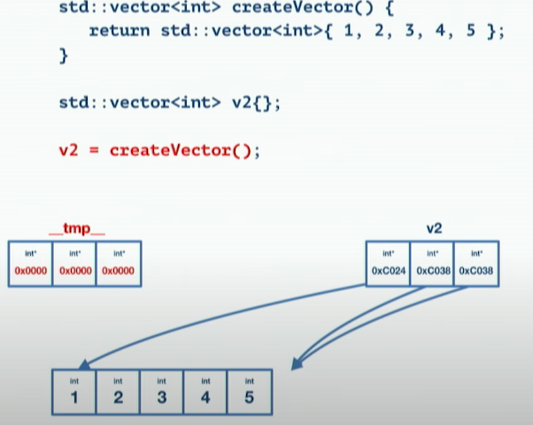
Move Semantics
(This is the
desired action)

Slide 59
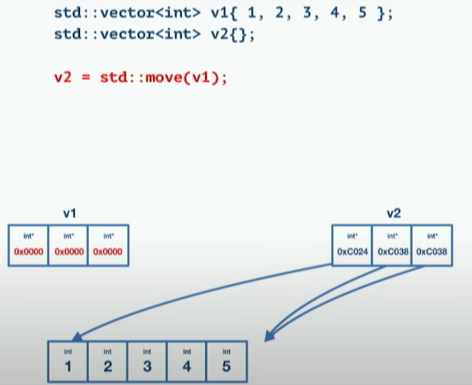
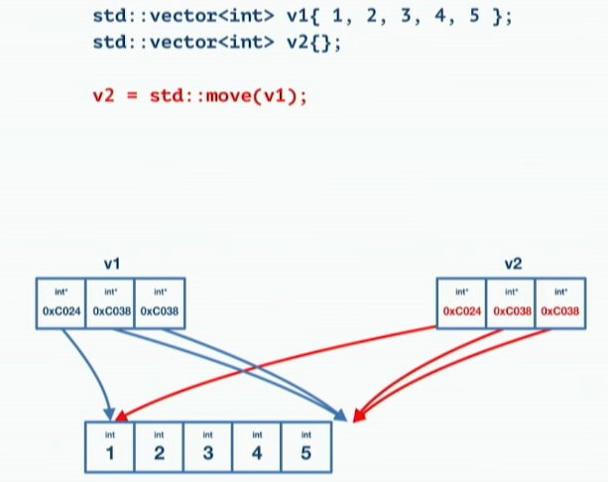

Slide 60
Move Constructors
Note r-value reference
  Says it’s safe to take a’s implementation from it
  Promises only subsequent operation will be destruction
Note constructor design
  A lot like shallow copy constructor’s implementation
  Except, zeroes out state of a
  No sharing, current object owns the implementation
  Object a is now safe to destroy (but is not safe to do anything else with afterward)
// takes implementation from a
IntArray::IntArray(IntArray &&a)
: size_(a.size_),
values_(a.values_) {
// make a safe to destroy
a.values_ = nullptr;
a.size_ = 0;
}

Slide 61
Move-Assignment Operators
No allocation, so no exceptions to worry about
  Simply free existing implementation (delete values_)
  Then copy over size and pointer values from a
  Then zero out size and pointer in a
This leaves assignment complete, a safe to destroy
  Implementation is transferred from a to current object
Array & Array::operator=(Array && a) { // Note r-value reference
if (&a != this) { // still test for self-assignment
delete [] values_; // safe to free first (if not self-assigning)
size_ = a. size_; // take a’s size value
values_ = a.values_; // take a’s pointer value
a.size_ = 0; // zero out a’s size
a.values_ = nullptr; // zero out a’s pointer (now safe to destroy)
}
return *this;
}

Slide 62
Move Constructor
class A {
public:
A (const A&){...} // Copy
A (A&&){...} // Move
};
// C example program on course page

Slide 63
Copy Elision
A Return Value Optimization (RVO)
Done by compilers when a local object is returned by value.
It is done automatically without need for Move constructor.
It has the same effect although it works a little different.
  Object is built the final place where it should be.

Slide 64
Vector push_back
std::vector<T>::push_back() creates a copy of the argument and stores it in the vector
Since C++11, push_back() will perform a move instead of a copy if the argument is an rvalue reference. (Objects can be converted to rvalue references with std::move())

Slide 65
Vector push_back
void push_back (const T& value);
void push_back (T&& value);
T must meet the requirements of CopyInsertable in order to use overload (1).
T must meet the requirements of MoveInsertable in order to use overload (2).
https://www.youtube.com/watch?v=HcESuwmlHEY

Slide 66
Why ??
int a1 = 0;
int b1 = 0;
int a2 = 0;
int b2 = 0;
a1 = ++++b1; // Compiles
a2 = b2++++; // Does not compile

Slide 67
What does this code print?
int& get_value() {
static int value = 2;
cout << "Inside: " << value << endl;
return ++value;
};
int main() {
int i = 5;
get_value() = 7;
cout << "Outside: " << get_value() << endl;
}

Slide 69
https://www.geeksforgeeks.org/copy-constructor-in-cpp/

